Slide 1



💎
💎
💎
💎
GameStop
POWER TO THE PLAYERS
Rally “To the Moon”
POWERED BY THE PEOPLE
Notes:
Intro: Naydeen

Slide 2


Introduction
The Big Questions??
How does social media affect today's stock market?
What does this mean for retail trading and fair
market valuation?
Why did the share price rise so fast?
Dzou Mei
Brie Pfisterer
Naydeen Monzon
Javier Pardo
Aaron Lew
Notes:
Naydeen… Team Introduction …. Naydeen

Slide 3





What is option trading?
What is a “short squeeze”?
What part did social media play in causing the squeeze?
How long could this rally last?
Technical
Overview
Notes:
Aaron

Slide 4
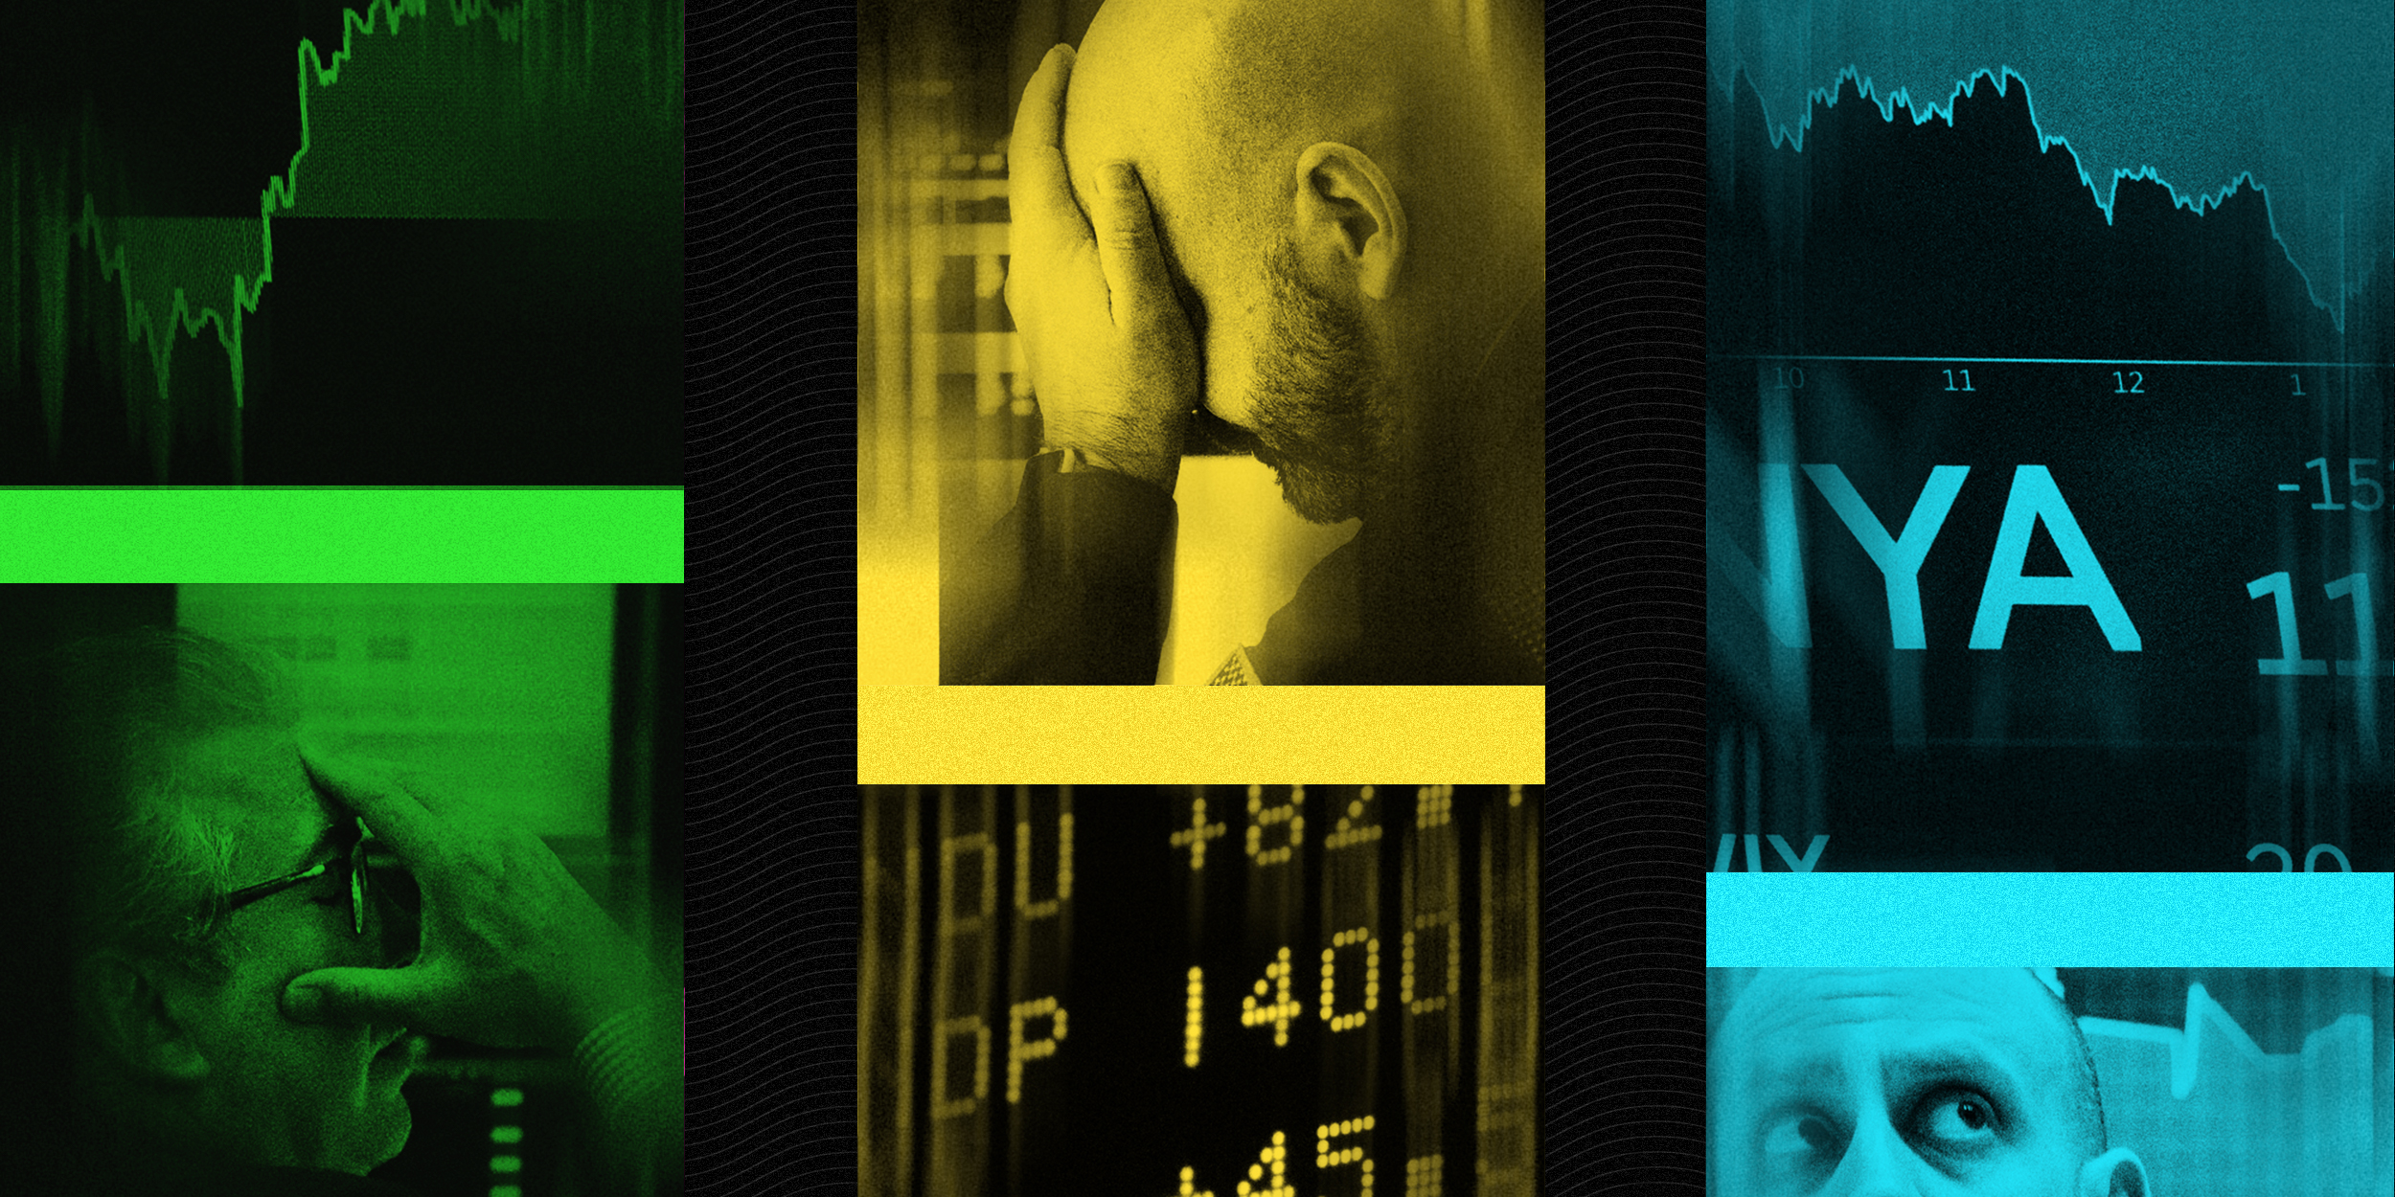
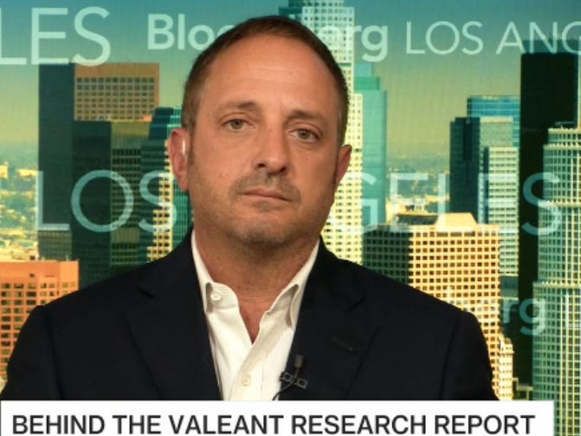
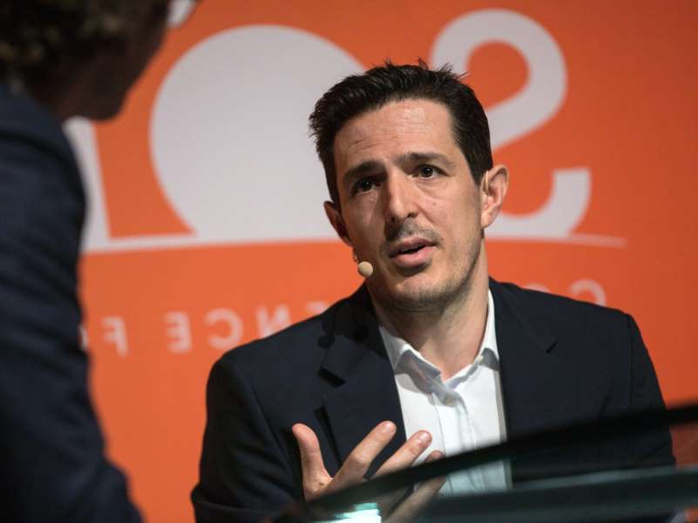
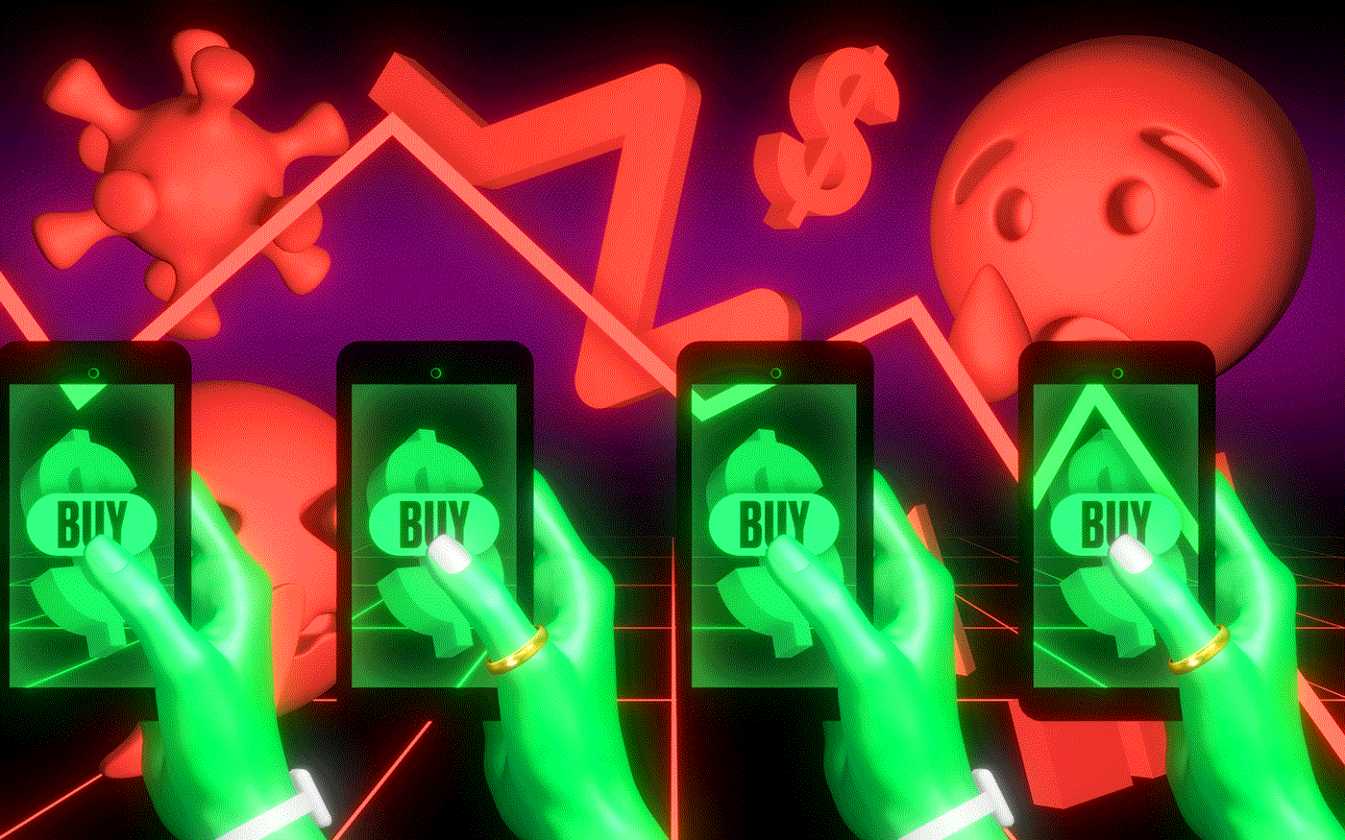



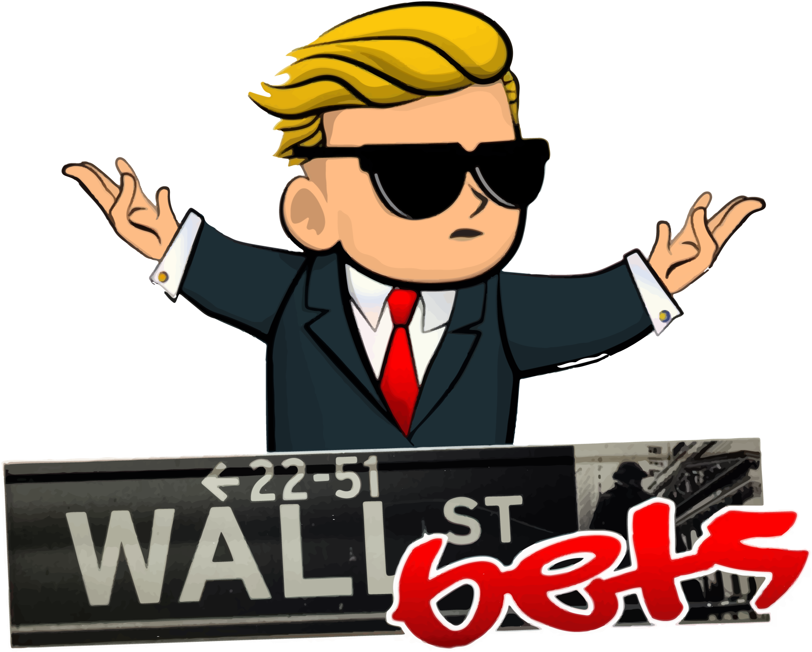


Key Players
💎
🙌

Slide 5
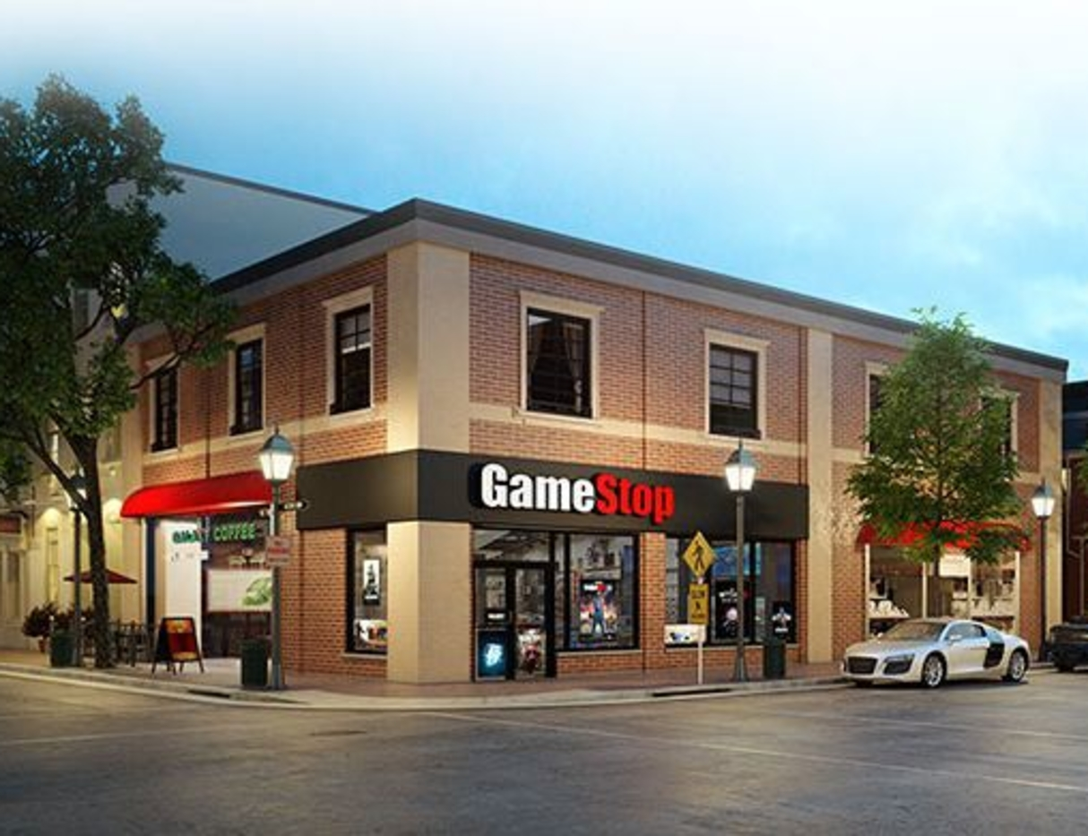

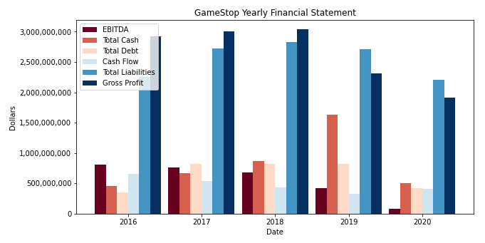



GameStop Financial Overview
GameStop is the world’s biggest video game retailer.
Business decline due to shift on video game download.
Declining EBITDA shows no growth.
Cash to debt ratio is average rating.
Notes:
Naydeen

Slide 6
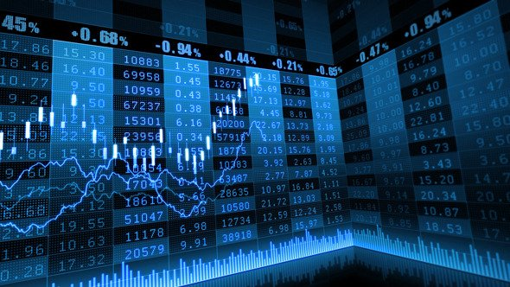
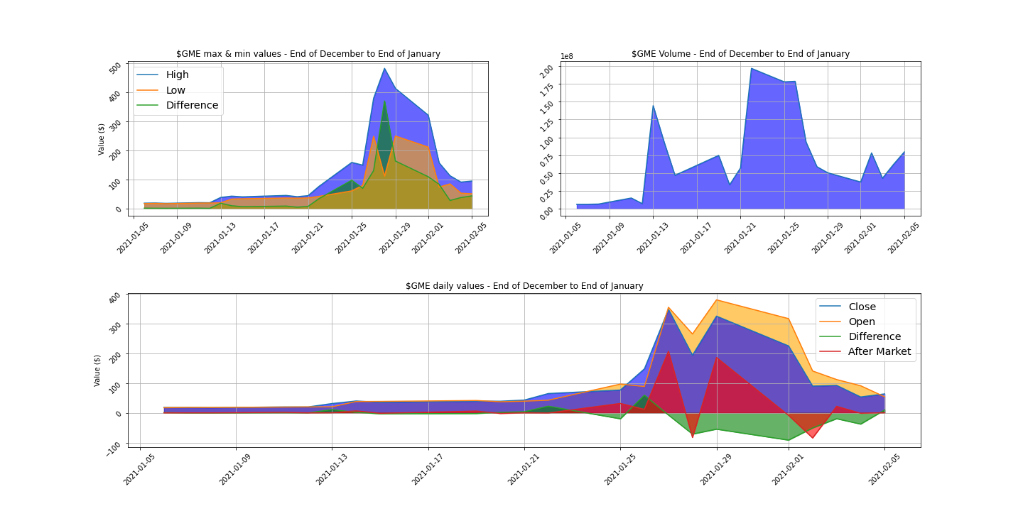
GME Stock Analysis
Notes:
Javi

Slide 7
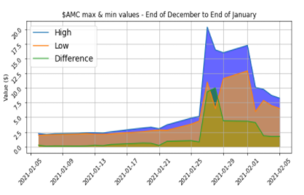
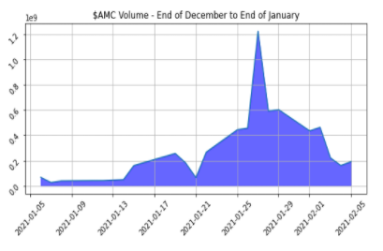
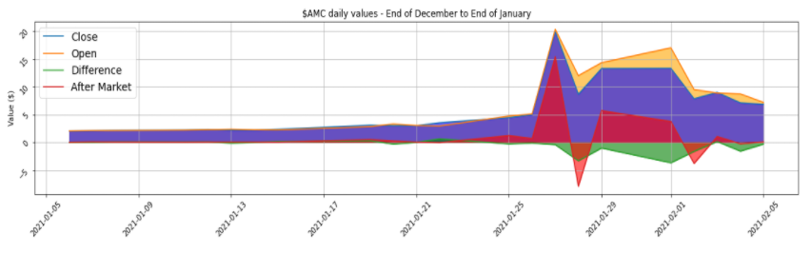
AMC Stock Analysis
Notes:
Javi

Slide 8
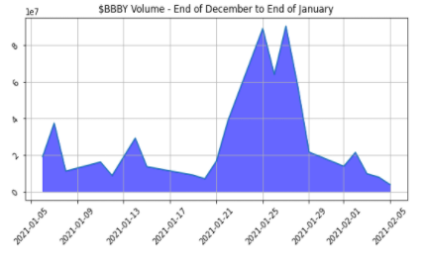
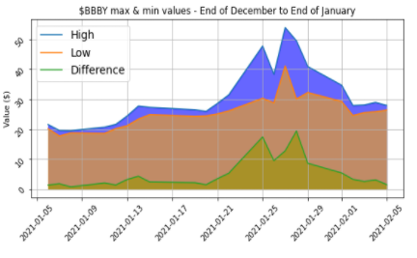
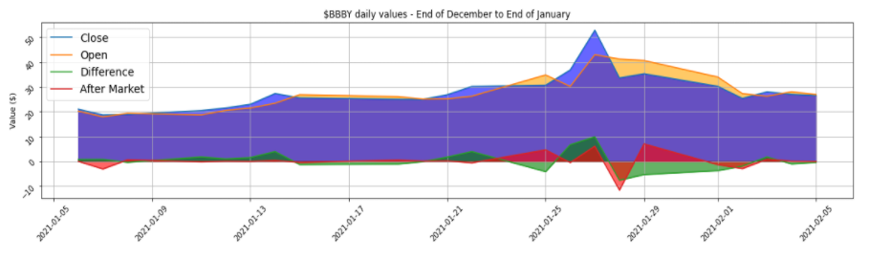
BBY Stock Analysis
Notes:
Javi

Slide 9
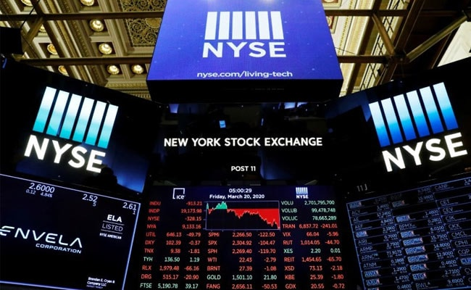
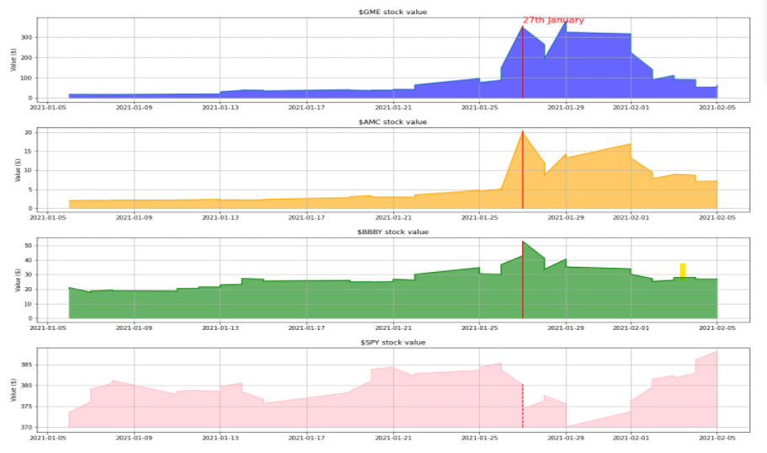
Stock Analysis
Notes:
Javi / Naydeen

Slide 10
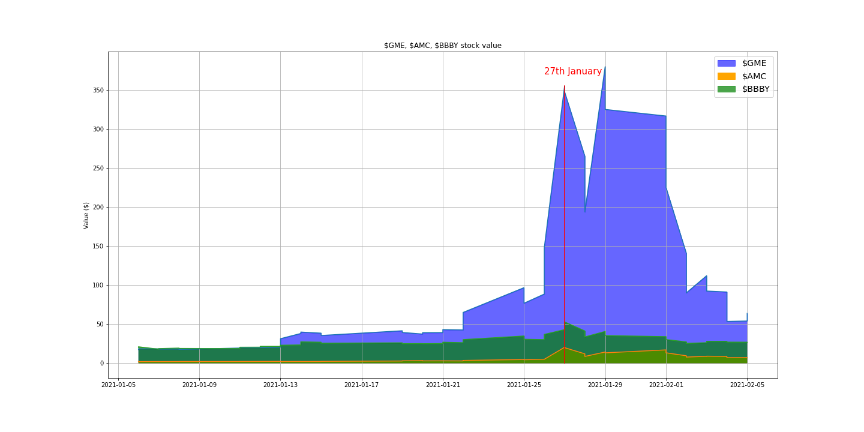
Stock Price Comparison
Notes:
Javi /Aaron

Slide 11
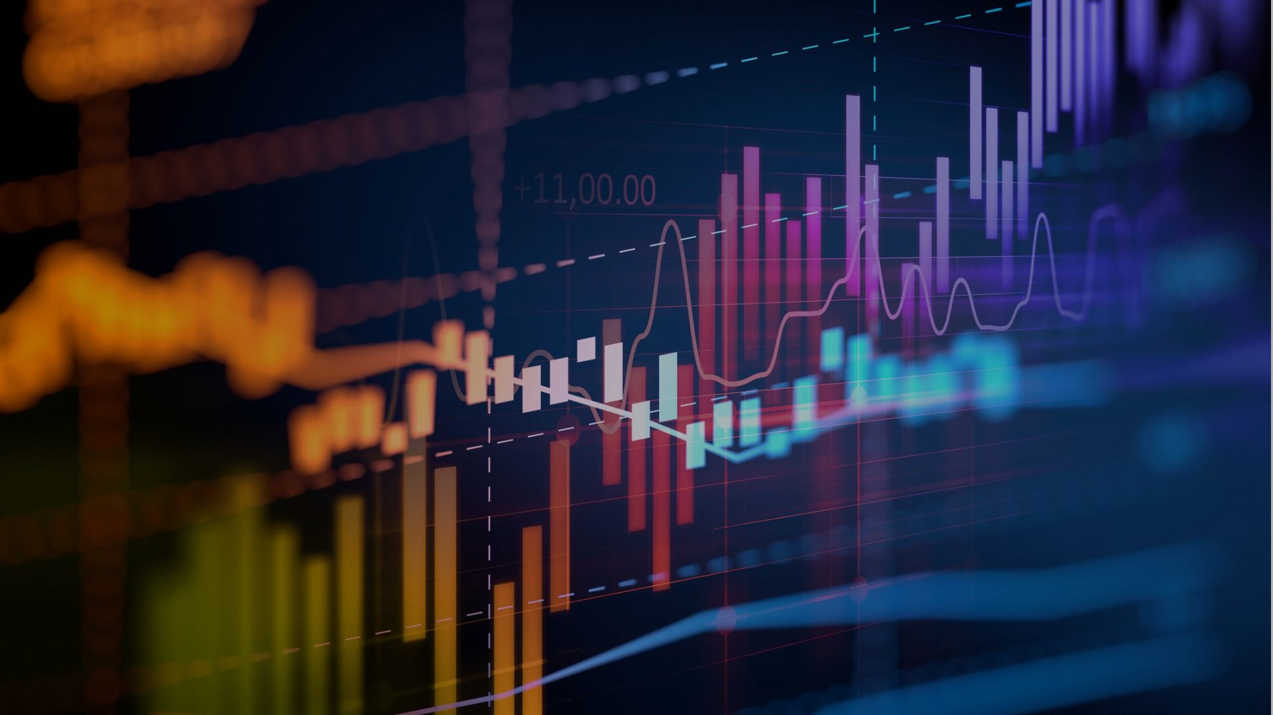
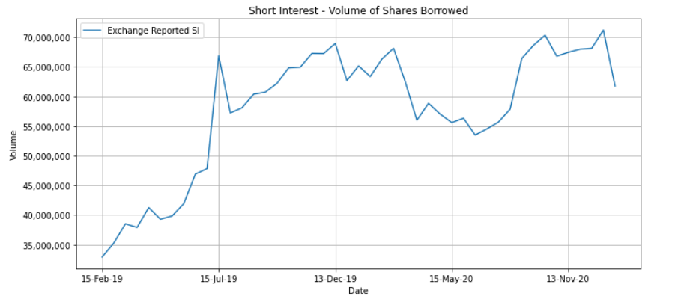
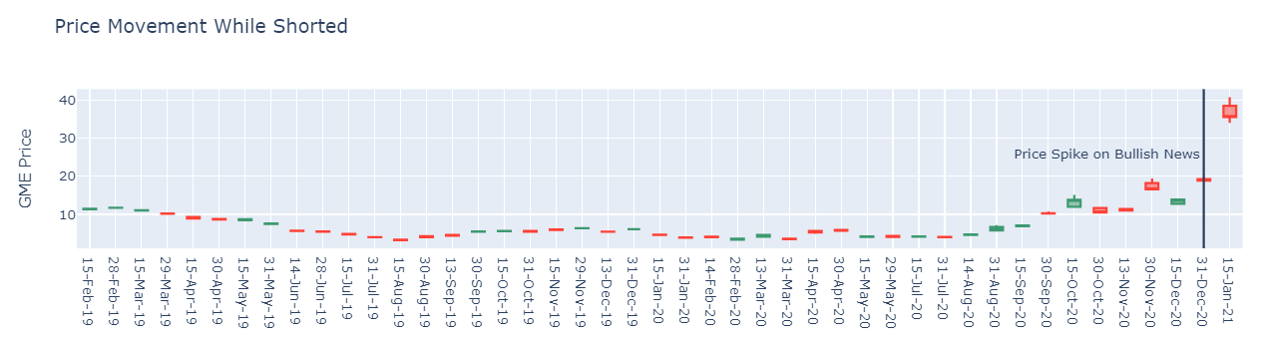
Short Interest Analysis of GameStop
Notes:
Aaron

Slide 12


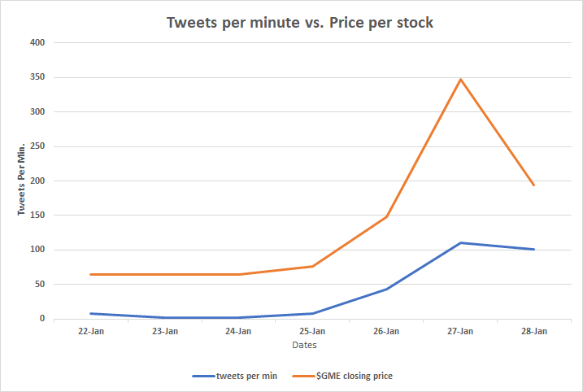

How does twitter activity affect stocks?
Positive correlation
Twitter activity:
Price
General perception on “wallstreet” is the stock value already too high
Low: 2 tweets per min
High 110 tweets per min
Notes:
Joe
Positive correlation as price of stock grew, tweets per minute also increased
Gamestop price looked to be growing exponentially
Tweet activity was at 2 tweets per minute and quickly topped out at 110 tweets per minute
Significant price drop Jan 28 due to trading halt on various brokerages
GME stock prices even at the most recent low was

Slide 13


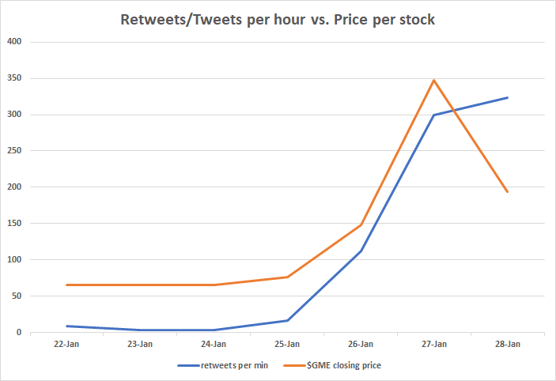

Twitter Activity
Strong positive correlation between twitter interactions and the price of the stock.
As the stock price rose the number of twitter activity followed.
Notes:
Joe
When we add retweets and tweets into a measurement it’s activity went hand in hand with the rise of gamestops stock price.
GME stock price peaked at $348
Twitter activity peaked at 323 per minute
On January 28th buying was halted on various brokerages, which drastically dropped the price as investors were only able to sell their shares.

Slide 14

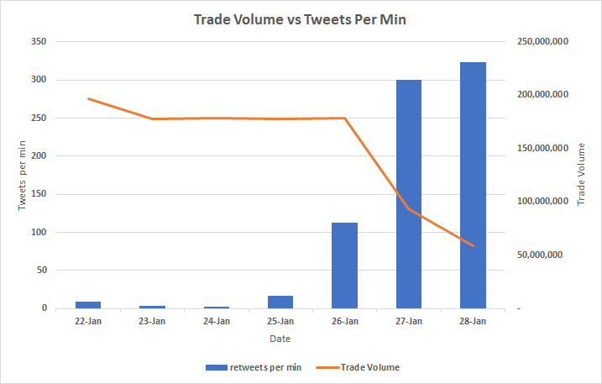

Trade Volume
Trade volume and twitter activity inverses
If tweets per minute are up shouldn’t the trade volume also be up?
Notes:
Joe

Slide 15

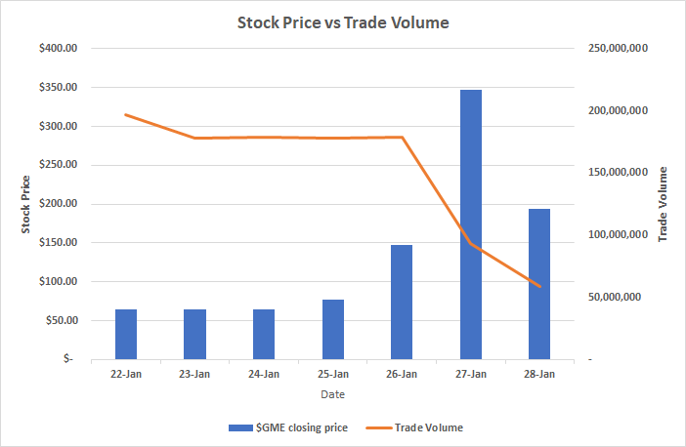


Trade volume cont.
As price of stock increased trade volume decreased.
Share price became too high of an entry point for many people and caused trade volume to decrease
Most of the available shares are then held by institutions and traders which reduces liquidity in trades.
Notes:
Joe
As price of stock increases trade volume decreases.
More investors bought and held onto stock, which was one of the main points to create the squeeze.
Hedge funds tried to cover losses as well as retail investor frenzy.

Slide 16

Summary
Activity on social media appears related to stock market activity
Positive correlation between tweets per minute and The GME stock price
Highest values for both were on Jan 27th, when GME reached a high of $371.51
What does this mean for retail trading and fair market valuation?
Social media helped expose some very powerful hedge fund’s weaknesses, and proved that when people using their collective power, they can out maneuver them on a macro scale as seen with Gamestop.
Why did the share price rise so fast?
Hedge funds with short positions were forced to buy back shares at elevated prices while there was low liquidity in share volume.
The influx of retail traders that were buying call options forced market makers to buy large quantities of shares to hedge.
Elon Musk tweet
Notes:
Brie

Slide 17





Data Sources
Historical market data - Obtained using the ypython package (Yahoo Finance market data downloader)
Short Interest data - Obtained from Ortex financial database
Trade halt data - Obtained using IEX Cloud API (focuses on financial data)
Twitter data - Obtained using Tweepy, a python library for accessing the Twitter API
Notes:
Brie

Slide 18

Challenges and Limitations
Paywalls
Data on financial details of stock trading is mostly behind paywalls, especially historical option trading.
Publicly available information is primarily in aggregate or incomplete
Limited pull rates
Social media sites limit the number of tweets/comments you can pull (900 tweets for Twitter, 100 comments for Reddit)
Reddit
Another limitation is the lack of Reddit data, and particularly the subreddit wallstreetbets. The reddit api is complex.
Attempts were made to extract data using PRAW, a python wrapper and Pushshift API but were not successful.
Notes:
Brie

Slide 19

Questions?

